Slide 1
A MACHINE
LEARNING APPROACH TO GENE EXPRESSION ANALYSIS FOR
CANCER
CLASSIFICATION
Discussed by Vincenzo Marciano', 282004
M A T H E M A T I C S F O R M A C H I N E L E A R N I N G

Slide 2
WHY MACHINE LEARNING IN GENOMICS
Currently, biomedical research attempts to explain the mechanisms by which develops a particular disease, for this reason, gene expression
Efficient Rapid Reliable
Robust to mistakes
studies have proven to be a great resource.
In a parallel way, Machine Learning techniques spread out in a multitude of applications, derived from other severals Science branches: medical diseases’ classification is one of them. From Parkinson to Breast Cancer, more and more improvements have be made through the years.

Slide 3
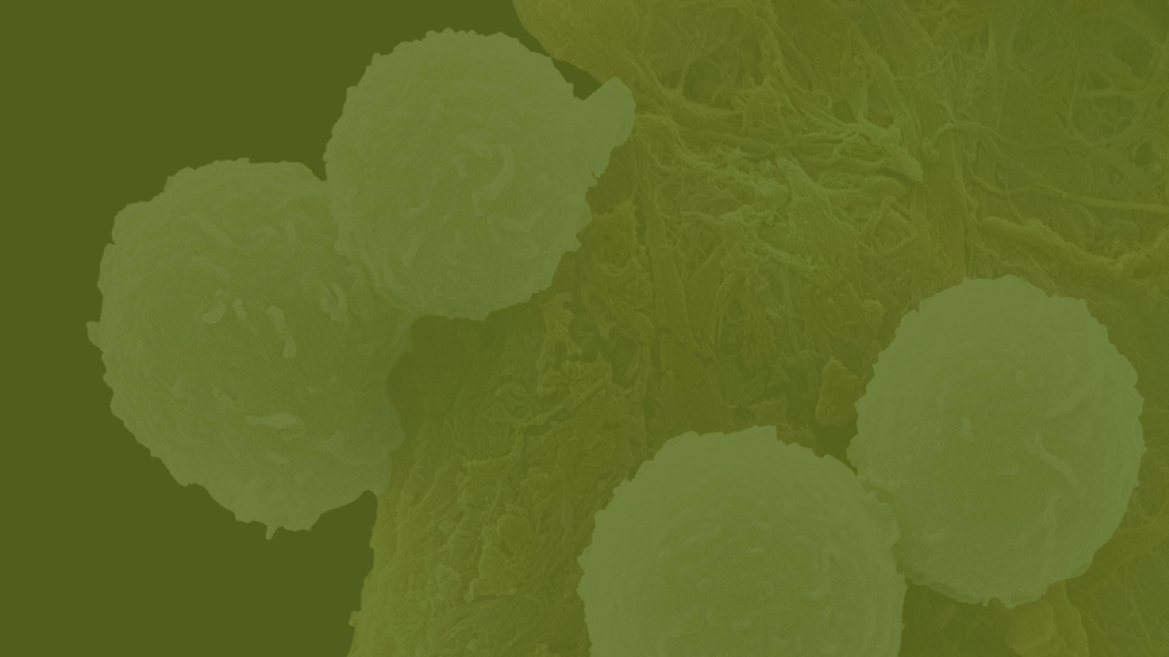
LEUKEMIA: AML vs ALL
Our purpose in this work is to study a considerable selection of ML algorithms in order to achieve the best performance possible, at least for those who are the expected final results in cancer classification of two types of Leukemia:
starts in cells that become lymphocytes, i . e. white blood cells that are an important part of your
immune system. About 80 % of childhood leukemia
cases are this type.
AML
begins in early myeloid cells, i . e. cells that become white blood cells ( other than
l ymphocytes), red blood cells, or platelet- making cells. I t ’ s the most common type of leukemia in older people.
AML

Slide 4

PROBLEM OVERVIEW
DATASETS
Training Set (7129 gene descriptors x 38 patients) Test Set (7129 gene descriptors x 34 patients) Label Set (categorical, 72 rows)
CLEAN AND TIDY DATA
Exchanging rows with column: gene activations as features, patients as samples
Binary Encoding: ALL = 0, AML = 1 Standardization
BINARY
CLASSIFICATION PROBLEM

Slide 5

WHAT COULD WE
EXPECT?
EXPLOITING MACHINE LEARNING TECHNIQUES
PCA mixed with certain classifiers (for example linear SVM, K-means, Naive Bayes) is an intuitive idea, since we have a very high dimensionality data to deal with.
Random Forest Classifier behaves very well even if we don't apply any reduction to the set: it works with several subsets of data in a very efficiend decorrelated way.

Slide 6


EVALUATION METRICS
NOT THE SAME STUFF!
Evaluation Metrics are truly important tools in determining how well our classifier is behaving. The widely-used metric is Accuracy (0 to 1) and it will be exploited also in this work.
Nevertheless, taken alone, it says nothing about our model in a "specific" way: we are dealing with cancer classification and we cannot permit to ourselves a large margin of error in False Positives / False Negatives predictions. That's why MCC metric comes in handy and explains to the user the overall behaviour of our classifier, from -1 to +1 score.

Slide 7

PCA
The problem is focused in the Variance Maximation carried by our features and, given a reasonably threshold of 90%, in understanding how much of them contributes to the overall Explained Variance Ratio
spread.
PACKED DATA
PCA is a very powerful tool which aims to reduce a high dimensionality set of data into a bunch of compressed features.

Slide 8
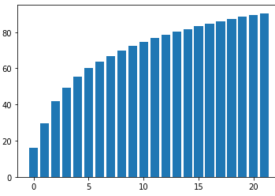
EIGEN- DECOMPOSITION
DEEPER
Through a deep analysis in the Eigendecomposition of our Covariance Matrix and sorting in descending order all the eigenvector by their contribution given to the overall Variance, we achieve a almost-zero
value by the 38th element.
Applied to our previously defined Explained Variance Ratio threshold we obtain eventually a 22-dimension data: not bad at all!

Slide 9
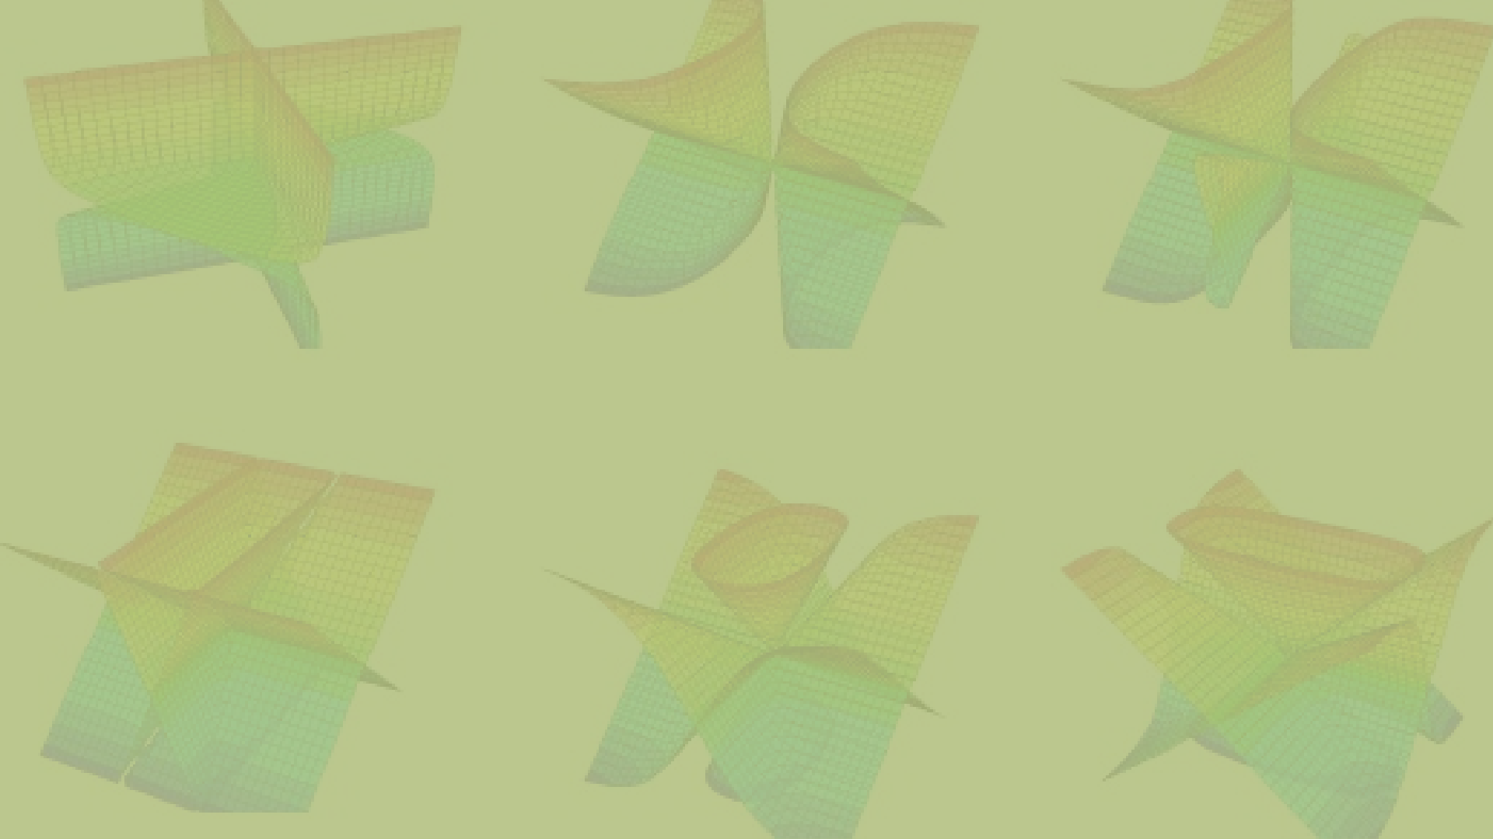
MACHINE L ARNING MODELS SVM
MASTERING THE HYPERPLANE
Support
Vector tackle
Machines ( SVM) are widely
used to
the sample complexity and
1
computational complexity challenges raised
Accuracy
up by the high dimensionality of feature
0.912
0.941
MCC
0.887
space.
0,75
0.827
0,5
Kernel operations:
exploited in order to avoid long and
computationally extensive calculations dealing with inner products among
instances instead of raw functions mapping
0,25
0
Scaled
PCA

Slide 10


MACHINE LEARNING MODELS K-MEANS
GROUP ' EM ALL!
Even i f we observe the lack of ground truth, which is a common problem in unsupervised
1
0,75
0.853
Accuracy MCC
learning methods, Clustering still remains one of the most powerful way to organize the data in some meaningful way.
0.717
0,5
0,25
0
0.147
K- Means Clustering: Approximation of
the Clustering
-0,25
optimization problem.
-0,5
Choose a parameter k such that i t ’ s the
-0.717
most suitable for the given problem:
-0,75
Scaled
PCA
CURSE OF
Clustering by f inding minimum distance between the i th- centroid and a sample
DIMENSIONALITY!

Slide 11
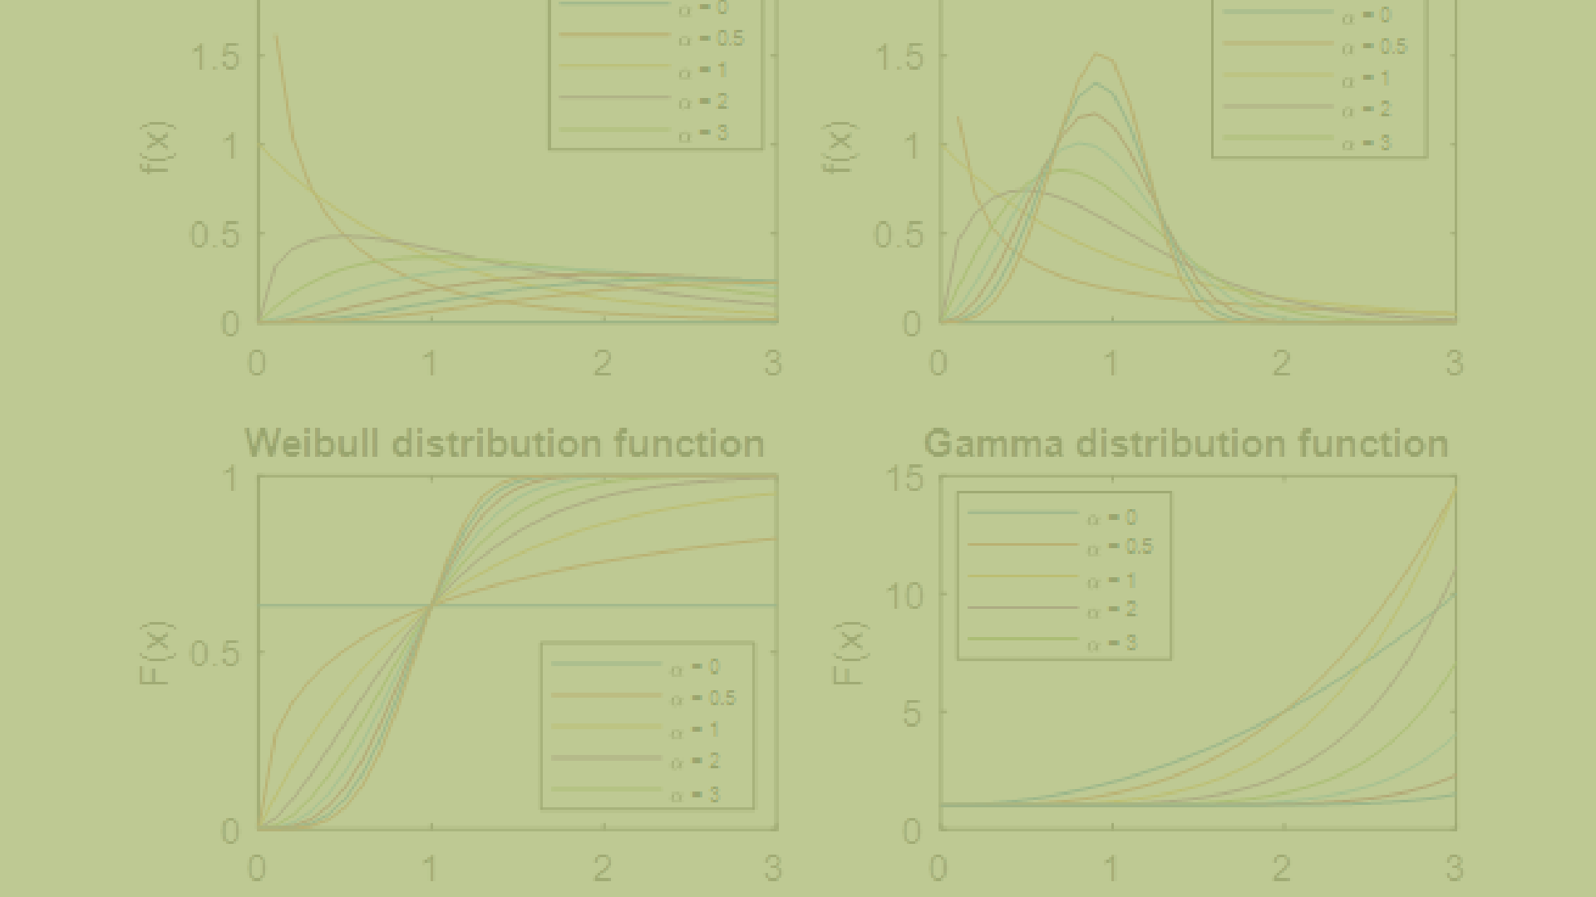
CH ARNIN
DEL NAIVE BAYES
STATISTICALLY HIGH RELEVANT
The Naive
Bayes
classifier is a classical
demonstration of how generative assumptions
1
and parameter
estimations s implify the
is the
Accuracy
learning process.
Sometimes
0.912
0.941
MCC
0.879
computationally easier
to estimate
0,75
0.821
parameters of the model
than to learn a
discriminative predictor
0,5
Gaussian Naive Bayes:
Gene descriptors' behaviour modelled as Gaussian RV
Using MLE to f ind estimates
0,25
Naive assumption: all the features are
0
independent variables
Scaled
PCA

Slide 12

RANDOM FOREST
The problem is focused in finding a way t create an ensamble of trees which guarantees.
the decorrelation among them. his possible by exploiting the Bootstrap
technique, which may prevent the same sub
of informations to be processed again, d a fine Hyperparameters Tuning pr
DIVIDI ET IMPERA
forest is a classifier consisting of an of trees (a collection of decision trees) ch final prediction is based on the majority eraging for Regression Tasks) over the s among each group of trees.

Slide 13
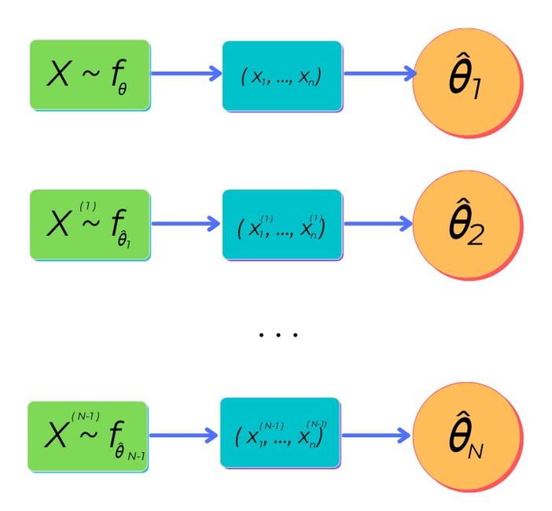
BOOTSTRAP
RESAMPLING IS THE KEY
Bootstrap goal is to repeatedly select (N times) a random sample with replacement of the training set X and fit the trees with this updated
data
That’s why Bootstrap sampling is a de- correlated way to approach each tree family: by showing them different training sets everytime, it decreases the overall variance, yet maintaining the same bias.

Slide 14


NDOM FOREST
HYPERPARAMETERS TUNING
STATISTICALLY HIGH RELEVANT
One can be interested in understanding how the PCA
1
reduced set could be useful in our RF application:
0.970
Accuracy MCC
nevertheless, we need to take in mind that each child
0.94
tree better improves i ts learning by studying original
0,75
( or at least scaled) features. This is done thanks to a Grid Search above all proposed configurations.
0.735
0,5
0.535
Hyperparameters to be tuned num of estimators - 400
max features - 0. 6 max depth - 3
min samples split - 12 min samples leaf - 2 bootstrap - True
- BEST:
0,25
0
HYPOTHESIS
Scaled
PCA
CONFIRMED!

Slide 15
PERFORMANCES
RECAP
Accuracy MCC
Tuned RF with Scaled Data
THE MORE I KNOW, THE BETTER
Linear SVM with PCA
Overall, the models behaved very well. Among those, Random Forest Classifier with a fine Hyperparameters Tuning on the scaled dataset has achieved the best accuracy and MCC score
possible.
NB Gaussian with PCA
k-Means with PCA
0 0,25 0,5 0,75
Best configuration for each proposed model
1

Slide 16

( VERY) BIG DATA
CONCLUSIONS
Genomics databases are truly highly data populated folders. For this reason, in further works, may be useful to exploit fine-tuned Random Forest Classifiers to surf across all these infos.
NOT SO STRAIGHTFORWARD
Certainly, against high dimensional data PCA is a very powerful weapon. However, it could be convenient to explore other paths, that could give the best by learning informations through a large set of features.
" IT ' S | GOOD | BECAUSE | IT ' S | DONE
THIS | WAY"
We grew up by a "trial and error" approach and for cancer-related topics we can't allow to us not to put much effort in avoiding mistakes. Maybe, we can discover new valuable models that aren't so trivial.

Slide 17
THANKS FOR YOUR
ATTENTION!
VINCENZO MARCIANO', 282004

